Slide 1



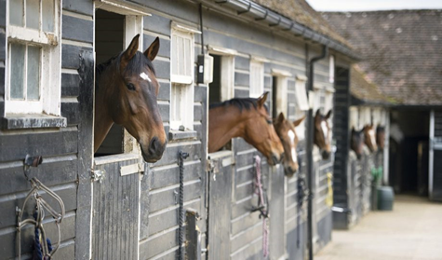

Equine Groom Level 2
Apprentice Information

Slide 2

Overview:
In this presentation we will cover:
Overview & Duration of the apprenticeship
Course Topics
Training through to final assessment
Getting started- initial interview and visits
Additional Curriculum Topics
E-portfolio
Off Job Training Requirements
Maths, English & Digital Skills (Functional Skills)

Slide 3
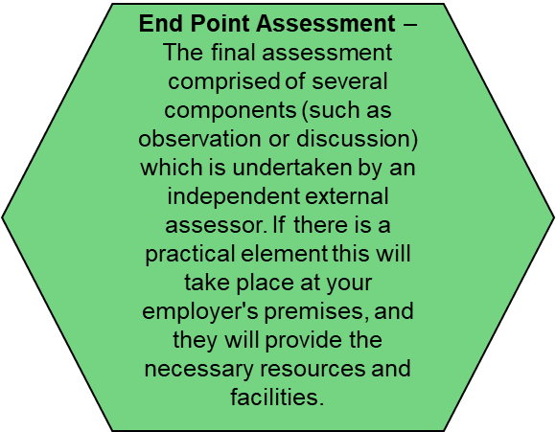
What is an apprenticeship?
An apprenticeship consists of:
The Standard - . the skills, knowledge and behaviours required to achieve your apprenticeship and do this job.
Gateway
This is a meeting to confirm you have completed:
All necessary training,
Maths & English requirements,
any additional industry tests,
All required off job training hours
your showcase portfolio
Maths & English
For 16 – 18 yr old yr olds, you will need to complete Functional Skills maths and English tests if you don’t have a GCSE grade 4 / C or above. For 19+’s this is optional
End Point Assessment
This is a 1:1 assessment conducted by an external examiner, similar to a driving test and usually comprises of a practical assessment and discussion

Slide 4
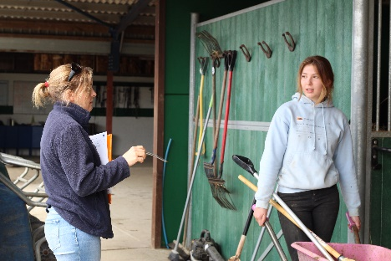
The Apprenticeship
The course will last for 16 months and will be completed by working closely with your KEITS Training Consultant (TC) and your in-house supervisor or mentor.
Your employer/supervisor will be provided with a curriculum/syllabus and details of all required training that will need to be completed during the course.
Your KEITS TC will undertake approximately 4 face to face visits over the period of the course plus 8 remote training and review sessions.
Remote sessions will be completed via: Microsoft Teams/Skype/Face Time/Smart Room on the E-portfolio (Smart Assessor)
This means that you will have a training session/review approximately every 4 weeks, each session/review will last between 2 and 3 hours. With dates and time to be agreed between the apprentice, the employer and the TC.
Your TC will always be on hand to support you via email and telephone between sessions/reviews.
If you have learning support needs, you may be eligible for extra support.
Regular communication is required between all parties (KEITS, learner and mentor) to ensure all required training is completed, necessary evidence is gathered and you are being supported effectively to meet agreed milestones/targets.

Slide 5
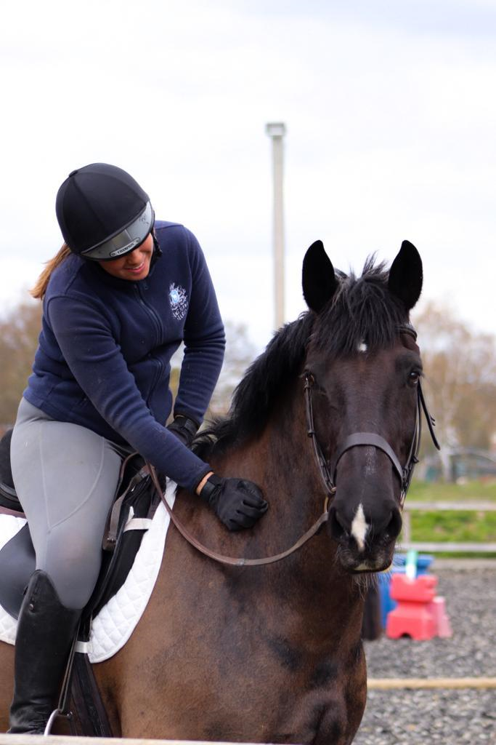
The apprenticeship - Topics
The Equine Groom apprenticeship is broken down into seven core topics:
Safe working practices
Yard and Field routines and duties
Horse anatomy, physiology and welfare
Horse handling, care and appearance
Saddlery and equipment
Travelling horses
Non-ridden exercise
Plus the specialist topic for the optional pathway selected (see next slide(s))
All will require development of skills, knowledge and behaviours

Slide 6
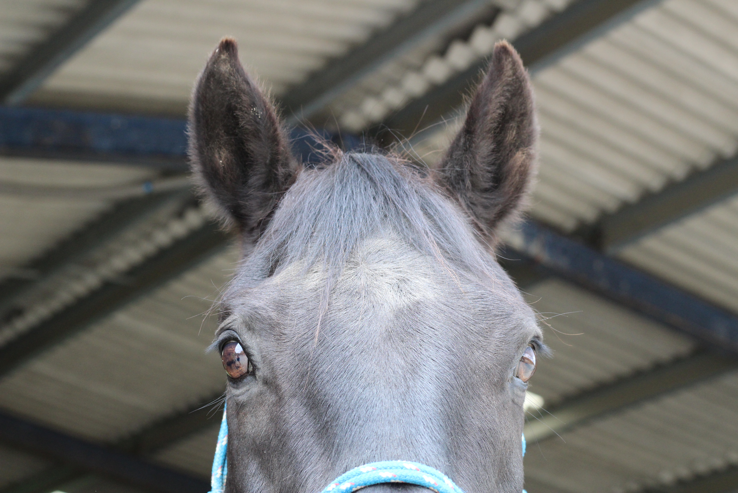
The Optional Pathways
Your chosen pathway will be discussed at sign up with input from your employer, your training consultant (TC) and yourself.
Not all pathways are detailed in this presentation, but your TC will be able to explain them to you.
You will also complete one of the optional pathway modules along side of the previous core topics:
  Riding
  Non-riding
  Breeding to be provided on request
  Driving to be provided on request
  Racing to be provided on request

Slide 7
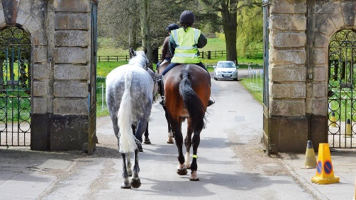
Optional Pathway Topic:
Riding
The topics covered include:
Adopting an appropriate balanced, basic riding position in walk, trot and canter
Riding an experienced horse in an enclosed area
Riding in an open space in a forward seat
Riding on the road or in a public place
Ride and Lead
Riding over ground poles
Understanding riding terminology including distances for pole work and the Highway Code.
Optional - Jumping a course of 6 show jump fences to a maximum height of 75cm to include two spread fences.
Evidence can be gathered in various ways; knowledge questions, case studies, work packs, projects, reports, photos or videos, direct observations, witness testimonies and professional discussions.

Slide 8

Optional Pathway Topic:
Non-Riding
The topics covered within this pathway include:
Assisting with storage of stocks and supplies
Contributing to the organisation and maintenance of establishment
Customer service
Office Duties including answering the phone, using IT systems
Contributing to the maintenance of yard records
Assisting and supporting riding grooms and provide non-ridden exercise
Lunging a horse for exercise
Evidence can be gathered in various ways; knowledge questions, case studies, work packs, projects, reports, photos or videos, direct observations, witness testimonies and professional discussions.

Slide 9
What your Equine Groom Apprenticeship will look like from start to finish
Pre enrolment checks including:
  Previous qualifications
  Eligibility (including ID and right to work in UK)
  Relevant prior experience
  Completion of skills scans
  Preliminary interview call (if relevant)
  Initial assessments which include maths and English initial assessment for all apprentices

Slide 10
Starting Your Apprenticeship
Remote Enrolment:
  Completion of necessary online, apprenticeship, enrolment forms
  Completion of online introductory learning activities
  Commencement of off the job training log
After your enrolment is completed, you will be contacted by your Training Consultant to arrange your induction and first training session.

Slide 11
Session Content
In each session you will cover some or all of the following:
  Training in Skills, Knowledge and Behaviours will be delivered by both your employer and your TC and your progress will be reviewed.
  Course work which may include case studies, projects, quizzes, collation of video and/or photographic evidence, work-books etc. will be set and assessed by your TC and you will be provided with developmental feedback to assist you with improvements.
  Your Off Job Training log will be reviewed and updated.
  TC’s will also provide training for the wider curriculum to include maths, English, Equality & Diversity, e-safety, Safeguarding, Prevent (including British Values) & relevant Information, Advice & Guidance.
  Directed work and study to be completed by next session will be agreed and recorded by you, your employer or representative and the TC.

Slide 12
Off Job Training
Off-the-job training (OJT) is defined as learning which is directly relevant to the course, undertaken outside of day-to-day work duties (but within normal contracted hours) and leads towards the achievement of the apprenticeship.
Your apprenticeship has a minimum requirement of 348 hours, which is approximately 6 working hours per week throughout the programme and this must be continually recorded by you in your OJT log on Smart Assessor.
The total hours shown above must be completed before you can undertake your Gateway meeting and progress to your End Point Assessment.
The Off the Job record is evidence that you have been engaged in active learning, failure to complete this record may lead to the funding being withheld and your apprenticeship may be suspended.

Slide 13
Some examples of OJT may include
Induction
KEITS on-line workbooks and resources
Industry specific health and safety training
Skills training & development
Skills practice
Vocational specific refresher courses
Training delivered by your employer/trainer or the KEITS TC either face to face or remote
Visits to shows or events related to the sector
Reading & research
Revision

Slide 14

The Apprenticeship – Gateway
Once you have completed the planned training which is expected to take you to within three months of the planned duration and your showcase evidence is complete, you will undertake a discussion with your trainer/manager and your TC to agree if you are ready for your End Point Assessment (EPA).
This discussion is called ‘Gateway’.
If all agree that you have undertaken all of the training requirements & have evidence to support;
  The required Off Job Training hours,
  Functional Skills Maths & English tests (if applicable)
  Competency and supporting evidence for all required skills, knowledge & behaviours
Your TC will work with you to prepare your showcase portfolio for EPA.
You will be given time and support to revise for your EPA or if necessary further training will be provided.

Slide 15
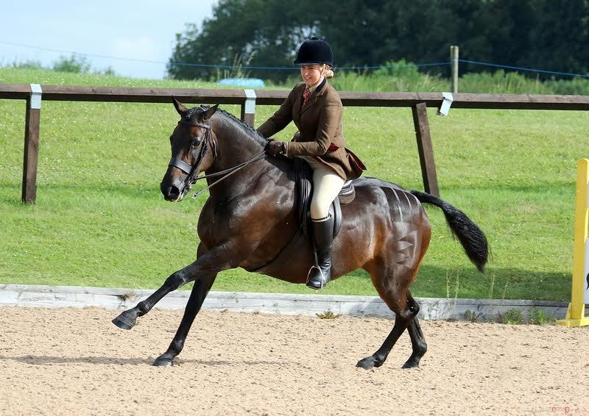
The Apprenticeship – End Point Assessment
Your End Point Assessment will be completed by an externally trained
professional, the Independent End Point Assessor (IEPA)
They will have been sent your Showcase folder to review.
The assessment will be carried out within 3 months from Gateway.
The Knowledge test – an on-line maximum of 75 minutes assessment of 50 multiple choice questions.
The Practical Observation - This Independent End Point Assessor (IEPA) will observe you carrying out practical tasks to cover a range of practical activities in your workplace. This may last up to 5 hours.
The Professional Discussion - They will also undertake a professional discussion around your knowledge, practical skills, behaviours and the work you have completed in your showcase folder. This will occur on the same day following the practical observation.
You must provide photographic identification on the day of the EPA to confirm who you are.
Your Training Consultant will make sure that you are fully prepared ☺

Slide 16

Wider Curriculum Topics
Throughout your program, you will also receive training and assessment on additional topics, including the below:
Safeguarding
PREVENT
British Values
E-Safety
Equality, Diversity & Inclusion
Well-being and Healthy Relationships
Study Skills
Understanding your industry
Careers information, Advice & Guidance.

Slide 17


Smart Assessor
What is it?
  Smart Assessor is a virtual platform used by KEITS to support training, gather evidence, collate assignments, assess work produced by the apprentice and for the TC to provide you with feedback. It is also the e-portfolio utilised for storing work towards the End Point Assessment and allows KEITS to monitor your progress in real time.
What does this mean for the apprentice?
  SA is a convenient method of communication between you and your TC. You will have access to bespoke training resources and learning activities and the ability to upload evidence/coursework directly to your account. Work is then marked and feedback can be given between visits. SA provides opportunities for discussion on work completed and also allows access to Maths and English & digital skills as well as wider curriculum materials.
How can employers contribute?
  Employers can access your portfolio to review your progress
  Provide access to the internet and technological equipment
Benefits
  All encompassing platform – one secure location for everything
  Saving the environment

Slide 18

Maths & English & Digital Skills
For learners aged 16-18 years old, you will be required to attend training sessions and complete maths & English Functional Skills tests if you haven’t already achieved a GCSE grade 4/C or above in either of these subjects. For 19+’s this is optional
All apprentices are expected to continue to improve their maths, English throughout their programme.
You will be provided with access to specific resources to develop skills gaps, as identified through our digital diagnostic tools.
Further opportunities will be provided through activities embedded within programme materials and tasks that you will undertake to provide evidence of competence for your apprenticeship.

Slide 19

Functional Skills 16 – 18-Year-Old Apprentices
Apprentices may need to achieve both Maths and English Functional Skills depending on their prior attainment.
Apprentices who have a grade 4 or above at GCSE, or Level 2 Functional Skill will be exempt from the associated Functional Skill.
Level 2 Apprentices |  | Level 3 Apprentices
Apprentices who have achieved a grade 1 to 3 at GCSE or a level 1 Functional skill (at sign up) will need to attempt the level 2 Functional Skill that they hold the grade 1 to 3 in. |  | Apprentices who have achieved a grade 1 to 3 at GCSE or a level 1 Functional Skill (at sign up) will need to achieve the level 2 Functional Skill that they hold the grade 1 to 3 in.
Apprentices who have not yet achieved a GCSE grade 1/permitted equivalent qualification or above will need to achieve Level 1 Functional Skill in the subject that they do not have a grade 1/ permitted equivalent qualification or above in |  | Apprentices who have not yet achieved a GCSE grade 1/permitted equivalent qualification or above will need to achieve Level 2 functional Skill in the subject that they do not have a grade 1/permitted equivalent qualification or above in

Slide 20
Functional Skills for Apprentices aged 19-Year-Old +
Apprentices in agreement with their employer can decide to opt in or opt out of undertaking functional skills. This decision is made at the beginning of the apprenticeship and cannot be revoked or the decision changed once agreed. The Apprentice must be aged 19+ at the beginning of their apprenticeship.
Apprentices who have a grade 4 or above at GCSE, or Level 2 Functional Skill will be exempt from the associated Functional Skill.
Opt in - Level 2 and Level 3 Apprentices
Apprentices who have achieved a grade 1 to 3 can opt to attempt the Level 2 Functional skill in the associated subject. They will need to attempt, but do not need to pass all components of the Functional Skills they have opted to do, to be eligible to undertake the End Point Assessment. Apprentices who have not yet achieved a GCSE grade 1/permitted equivalent qualification or above can opt to attempt the Level 1 or Level 2 Functional skill in the associated subject. They will need to attempt, but do not need to pass all components of the Functional Skills they have opted to do, to be eligible to undertake the End Point Assessment.

Slide 21
Functional Skills Training and Support
For apprentices who will be undertaking Functional Skills
    Those apprentices who are undertaking functional skills will complete maths and English online diagnostics to highlight both strengths and areas for further support – bespoke learning activities will then be generated for each individual apprentice from our online BKSB platform.
Apprentices will be expected to complete the bespoke online maths and English activities specific to their needs on the online platform (BKSB)
Apprentices will be required to attend a series of group online training sessions in both maths and English with a KEITS functional skills tutor.
One to One support sessions will be provided for those learners who hold an EHCP plan or Educational Statement.
Some apprentices may also find it helpful to complete relevant practice papers.

Slide 22
Functional Skills – The Test Components
Maths
Level 1 |  | Level 2
One assessment comprising of two test papers Non calculator paper Calculator paper |  | One assessment comprising of two test papers Non calculator paper Calculator paper

Slide 23
Functional Skills – The Test Components
English
Level 1 |  | Level 2
The Level 1 Functional Skills English qualification comprises of three separate assessments:- 1 Reading test 1 Writing test 1 Speaking, Listening and Communication (SLC) practical assessment – apprentices must attend an online training session in preparation for the practical (SLC) assessment. |  | The Level 2 Functional Skills English qualification comprises of three separate assessments:- 1 Reading test 1 Writing test 1 Speaking, Listening and Communication (SLC) practical assessment – apprentices must attend an online training session in preparation for the practical (SLC) assessment.

Slide 24

Added Value - Optional Extras
Health Assured
KEITS have a range of resources to support apprentices' wellbeing. In addition, apprentices have free access to Health Assured services which offers confidential support and advice on a range of topics such as, mental health, finances and bereavement.
British Horse Society
KEITS Equine Groom and Senior Equine Groom apprentices, can on completion of their apprenticeship apply to gain direct entry to BHS assessment. They can benefit from a 40% discount on assessment fees, with 20% provided by KEITS and 20% from the BHS.

Slide 25
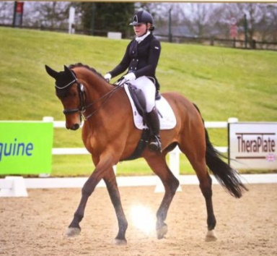
Any Questions?
  Your Training Consultant and the KEITS team hope you enjoy the course.
  Remember - we are here to support you.
  Your Training Consultant and the KEITS team hope you enjoy the course.
  Remember - we are here to support you

Slide 26




Contact Us
KEITS Training Services Ltd
P.O. Box 529
Hatfield
AL10 1JS
T: 0208 327 3800
E: info@keits.co.uk
W:www.KEITS.co.uk

